Slide 1
Leica Social Media Guidelines
Wetzlar, June 2019

Slide 2
Agenda
1.
2.
3.
4.
5.
The Leica Philosophy
Social Media Presence
Tonality
Visual Language
Photo Shares
6.
7.
8.
9.
Asset Creation
Video Guidelines
Channel Don’ts
Community Management
Appendix

Slide 3
1. Leica Philosophy

Slide 4
Leica Social Media Guidelines
Why Social Media Guidelines?
Our aim is to establish a uniform appearance and a strong brand image across all social media channels worldwide while at the same time supporting local initiatives.
Key Values:
strengthen recognition value
increase share of voice
support local content
These Social Media Guidelines are aimed at Leica partners and Leica subsidiaries which already operate social media channels. Please contact the Global Social Media Team for approval if you aim to establish such channels in the future.

Slide 5
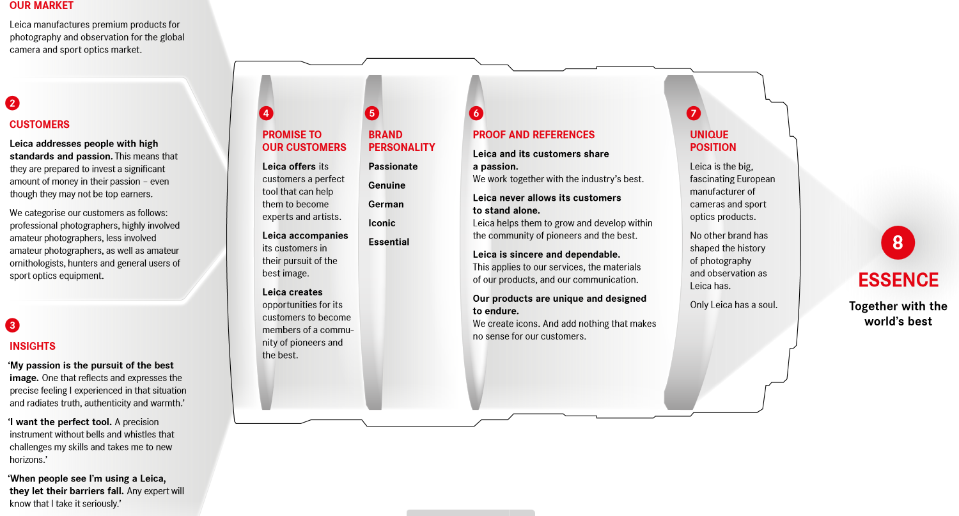
Leica Philosophy | Together with the World‘s Best

Slide 6
2. Social Media Presence

Slide 7
Social Media Presence | The Basics
Prerequisites
You produce enough content to warrant a social media presence
Start your social media presence with a business Facebook account
Once it‘s successful, start introducing additional channels based on availability and acceptance in your local market
e.g. use Instagram, Twitter LinkedIn etc. only if there are
sufficient demand and community in your market
Do you need a presence on every social media platform? The upcoming slides include an overview of all social media channels and which channel is best used for which type of content.

Slide 8
Social Media Presence | Channel Overview
Facebook Global Pages
Instagram
YouTube/vimeo
COMMUNITY POWER
Reach a broader, more diverse audience than on other channels by pushing posts with media budget
Possibility to target the audience
Product launches and product communication
Local Content → Events, Store openings, Gallery events
Age group: no younger people
VISUAL BEAUTY
Still a high reach with organic posts possible
Instagram stories is a good format to integrate video and storytelling content as well as event coverage and integrate a “swipe up” link ( possible from 10k followers on or for verified accounts)
Direct interaction with influencers
Product launches and product communication (Shop the product function)
Hashtag campaigns with influencers for a broad communication
Age group: Very broad
LEICA EXPLAINED
Local Influencer content
Event coverage
Corporate content catering to consumers as well
Tutorials
Notes:
mit dem Instagram Kommentar nichts anfangen

Slide 9
Social Media Presence | Channel Overview
Twitter
LinkedIn
NEWS
Events and live coverage
Fast, direct interaction with influencers
Exclusive news about product launches and product communication
High post frequency facilitates content of all priority levels
INSIGHTS
Inspirational corporate content
HR content – good if you search for employees
Event coverage from a corporate point of view
Reach people on a business level with advertising
B2B communication
Age level : older, business oriented audience

Slide 10
Leica Logo | Application
The Leica Logo – Golden Rules
TBD by Hilli
Is used as Channel Icon on Leica Social Media Channels:
All Leica markets must use the same Leica logo as the global channels. Customized country-specific logos are not applicable in order to give all Leica channels a streamlined, official appearance and recognition value. Do not change the design or colour of the Leica logo in any way. Only use the red version of the Leica logo.
On Social Media Post Graphics:
Leica logo icons are never to be placed on post graphics.

Slide 11
Social Media Presence | Facebook
Posting Interval Recommended
Social Media Image Formats
Not more than 2-3 posts per week, pushed with media budget (Advertising slide 12)
Facebook Cover Photo: 820 x 312
Facebook Profile Photo: 180 x 180
Facebook App / Tab Thumbnail: 111 x 74
Facebook Link Preview: min. 600 x 315
Facebook Group Cover Photo: 801 x 250
Facebook Event Cover Photo: 784 x 295
Facebook Photo Post: 1200 x 717
Crosslinked Image: 1200 x 628
Video: Square
Posting Length Recommendations
40-80 characters
Asset performance based on our experience:
Carousel Posts, Video Snippets, Product porn
Long videos, weak single images
A must-have channel for brands. The organic reach on Facebook is extremely low, so a media budget to push the posts is necessary.

Slide 12
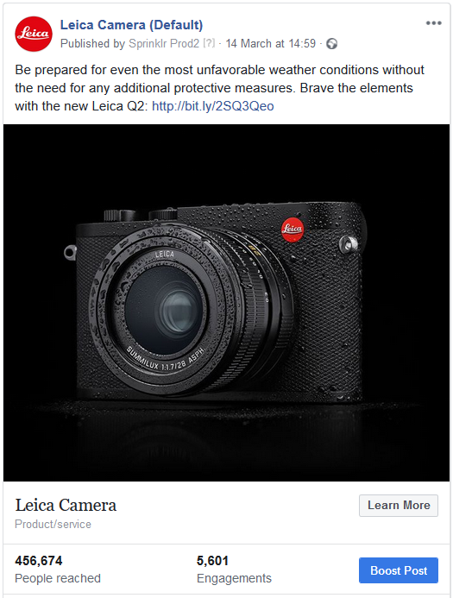
Social Media Presence | Facebook Advertsing
Advertising
On Facebook, organic posts are no longer working to reach the audience and especially a specific target group. Therefore it is necessary to push the postings with media on a local level with the correct language for an optimal placement. Here it is essential not to communicate with a “much helps much” mind-set to get the most out of the placed budget → Pursue an aim with your postings.
To make the best out of the cooperation, please coordinate the advertising with the Leica Social Media team (social@leica-camera.com) to avoid imprecise or double targeting.
Definition/ Best practices Leica HQ channel = Upcoming slides

Slide 13
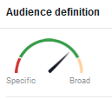
Social Media Presence | Facebook Advertising
In General:
Social posts should be pushed to increase the click rate (to the e-stores/landing pages of the website to push the sales) and to raise the awareness for the brand in general (increase the reach). In this contexts ads are best used with clearly defined target groups and a call to action.
Targeting
We distinguish between Traffic and Reach posts, that pursue different
goals.
Traffic posts (posts with the goal to generate link clicks):
The positioning of the products can be helpful to define product related areas of
interests. Try to define the target group as good as possible. The more exact the
target group is defined, the higher the click rate and the lower the Costs per Click
will be. As orientation Facebook Ad Manager has a audience definition indicator in
the target group section. That helps to get an orientation of how specific or broad
you are defining the target group with the settings you make:
Traffic posts should always include a clear CTA and a link! Example: “Follow the link
to learn more about the Leica S-System: https://s.leica-camera.com ”

Slide 14
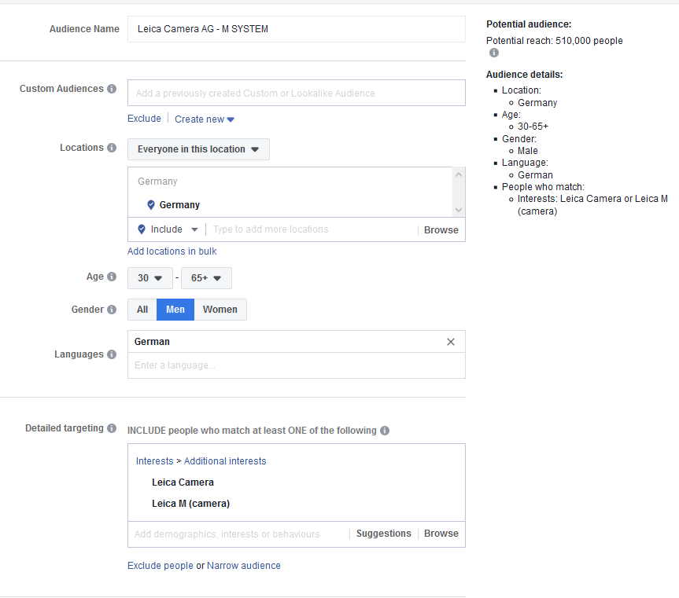
Social Media Presence | Facebook Advertising
Reach posts (posts with the goal to raise the awareness of the
brand): Here we can choose a broader target group. This can also be
brand unspecific topics to reach a higher number of users.
Budget: As usual in the digital advertising business, more is more to reach a
broader audience. But in the first steps start with a small budget to get a
feeling for the advertising mechanics and to learn what works best for your
local audience.
Age: In average we defined the age range from 25-65+ as a potential age
range for Leica buyers. Depending on the product the target group could also
be younger (lower priced products such as accessories or the Leica SOFORT, or
for the Leica TL2) or more specific.
Location & Language: If you want to promote a local event, please target
only the surrounding areas that make sense for the promotion.
For promotions that independent from local specific communication, please
don’t target audiences who are located beyond your sales area and use the
correct language for the selected region.

Slide 15
Social Media Presence | Facebook Advertising
Timing: Think also about the right timing. Based on our experience we publish postings around 4PM CEST/CET. Here we have the maximum overlaps with relevant time zones for postings around the globe.
Launches as well as national or international holidays and events are always a good opportunity to rise the awareness for a product. Launches have the advantage that they are very “Leica specific” and Leica interested people will search for keywords around the product. This is a good opportunity for a better ranking in the Facebook algorithm that results in a lower CPC and a better visibility. National or international events like Christmas is also a good opportunity to drive sales and reach the target group with paid advertising. The disadvantage is that you’ll be not the only advertiser with this idea. That makes it harder to reach the target group with a low budget.
Furthermore you have to keep in mind when people will have the most time for online shopping or surfing about products and upcoming event. So you should plan the advertising around weekends and holidays where people have the most receptive for advertisings and purchasing.
2. Assets
The assets should be platform specific and created in the relevant format.
3. Post copy:
Think and act like a customer. Put yourself in the place of the customer. Which keywords would you use to find the product you are promoting? What would you like to read in a text? Try to integrate that in the copy. Highlight features and the USP of the product and keep your text clear and snackable. Even if you pay for an ad placement you have to create content that wakens the interest of an user. Your goal is that the customers stops at YOUR ad while he or she is scrolling trough the platform with hundreds of posts and advertisings. Here a crunchy CTA as well as formulations like “NEW”, “LIMITED” or “NOW AVAILABE” help to catch the interest of the user and are click driver/trigger.

Slide 16
Social Media Presence | Facebook Advertising
Custom Audiences: The creation of a target group that is made from scratch as descripted in the previous slides is called “core audience”. Facebook Custom
Audiences are highly defined groups of people who already have a relationship with your business, such as past customers, people who have visited your website, or
people who have installed your app. Even better, Custom Audiences can be used to create lookalike audiences.
Lookalike audiences: The lookalike audience is based on the custom audience and generally means an "algorithmically-assembled group of social network
members who resemble, in some way, another group of members“. Lookalike audiences anatomize existing customers and their user profiles to find the
commonalities between the existing audience. This helps to find highly-qualified customers who previously would have been difficult to identify and reach. This
approach saves time and lowers advertising costs for the acquisition of a new audience.

Slide 17
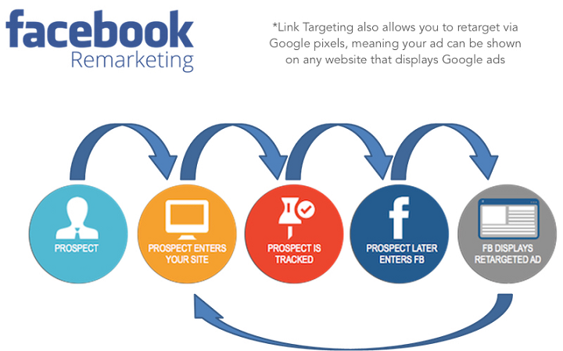
Social Media Presence | Facebook Advertising
The Facebook Pixel
To be as successful as possible with your ad, an implementation of a Facebook pixel on the landing page ( website or e-store) is necessary. The pixel tracks actions of the website visitors and can be used for creating a custom audience or retarget visitors of your site.
This way it is possible to create ads for users who have been already in contact with the brand and are highly relevant for a successful conclusion.
Here it is also important to implement a link tracking mechanism.

Slide 18
Social Media Presence | Instagram
Posting Length Recommendations
Social Media Image Formats
Instagram Profile Photo: 110 x 110
Instagram Thumbnails: 161 x 161
Instagram Square Photo or Video: 1080 x 1080 for max. Quality
Instagram Vertical Photo or Video: 1080 x 1350
use images in square, 5:4 & vertical format only
please crop images that are in landscape format
90 characters or less
include current campaign/blog link in bio
Posting Interval Recommend
Asset performance based on our experience:
Images with a clear focus , relevant influecer regrams, IG stories: including video snipptes and for direct linking with swipw up function
Videpost in feed, static product images with a grey background, classic portraits
Preferably 1, not more than 2 Posts per Weekday
1 Post per Day on Weekends
The organic growth on Instagram is still very good. A precondition for a successful Instagram account are good and highly visual images. No good images = no Instagram channel . If you have an Instagram business account you can integrate the “shopping function” with direct links to your E-Store. If you have 10k followers or a verified Instagram account, you’ll also be able to add a “Swipe Up” link to your Instagram Story. Another possibility for implementing links on Instagram is within the “bio” of the profile.

Slide 19
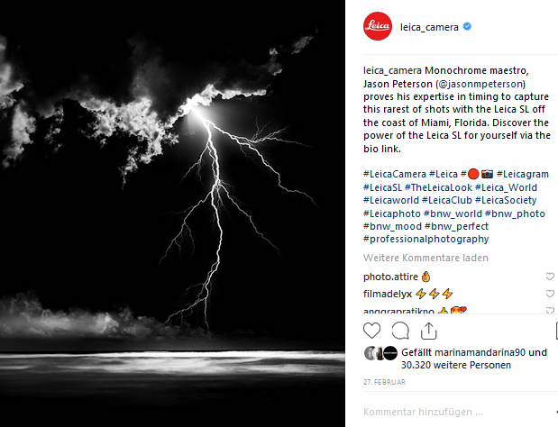
Social Media Presence | Instagram
Hashtags | General
Hashtags are emerging as a common branding tool and thread to track and tie conversations together. They also play a critical role in how people discover content, especially on Instagram and Twitter. It’s important to include a hashtag strategy into all of the marketing efforts.
You may use product hashtags outside of social media as well, e.g. they can be included in materials such as decals on walls, press kits, releases and boiler plates, Leica Camera video outros, print and event marketing communications.

Slide 20
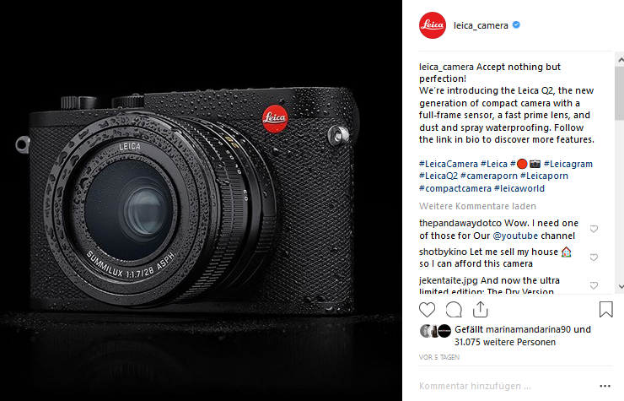
Social Media Presence | Instagram
Hashtags | Brand Hashtags
Brand hashtags are used as a branding tool to strengthen the association of Leica with the hashtag. The default brand hashtag for Leica Camera is #LeicaCamera across platforms. For Instagram, # 📷 is also a brand hashtag to be included in all posts.
Include Hashtags at the end of main post texts on Instagram and Twitter.
Tips: 1. Always make sure the hashtag is relevant and not tied to
an inappropriate meaning.
→ You can use the Tag Board to check the meaning,
appropriateness of hashtags.
→ If you want to establish a unique campaign hashtag, you
can also refer to this website to see if your chosen tag is
already in use.
2. Use as many hashtags as you want, just make sure they stay relevant.
Notes:
bei Tipps: hier habe ich eure Anmerkungen nicht verstanden

Slide 21
Social Media Presence | Instagram
Hashtags | Strategy
Custom & UGC Hashtags: These are created to brand and tie conversations together around specific campaigns, events or content formats such as #LeicaWorld, #Leicagram and #LeicaBlog #ShootLeicaPro…..
→Please, check first if the hashtags are existing
General Leica hashtags to be included in all posts:
#LeicaCamera
# 📷
Camera Hashtags: These should be used when an image is shot with or features a specific Leica camera, as for example:
#LeicaM #LeicaQ2 #LeicaTL2 #LeicaS #LeicaSL #LeicaM #LeicaDLux7 #LeicaCL …

Slide 22
Social Media Presence | Instagram
Hashtags | Trending Topics
Trending topics are hashtags that have been established to be commonly used by the social media community. Use them in order to increase your reach. But please check first if they are relevant. Here are some examples:
#portraits #landscape #streetphotography #blackandwhite #bnw #photography #minimalism #art #design #interiordesign #travelphotography #architecture #luxury #naturephotography

Slide 23
Social Media Presence | LinkedIn
Posting Interval Recommended
Social Media Image formats
2 – 3 Posts per Week
Profile Image: 200 x 200
Background Image: 1400 x 404
Company Banner: 646 x 220
Posting Length Recommendations
Asset performance based on our experience:
No significant difference between video or or image content, in both cases product porn works well
25 words or less
LinkedIn is highly relevant for B2B communication as well as for HR and corporate content.

Slide 24
Social Media Presence | Twitter
Posting Length Recommendations
Social Media Image Formats
Twitter Header Image: 1500 x 500
Twitter Profile Photo: 400 x 400
Tweet Image: 506 x 506 (1:1 Ratio) since 12/2015
Ads: 800 x 320 (Sizes may vary)
70 - 127 characters (+ postlink)
Images/videos are no longer included in the 140 characters count
Posting Interval Recommend
Up to 5 Posts per Weekday
1 Post per Day on Weekends
Twitter is highly relevant for short news and needs a constant screening and real time response. → very time-cosuming

Slide 25
3. Tonality

Slide 26
Tonality | Basics
Tonality
The tonality of Leica Camera is trustworthy, authentic and representative of Leica‘s excellent quality. It transports the actual strengths of the company. There is an appropriate mixture of informative and emotional language within every text. The texts move and touch the reader, make them curious while at the same time positioning the product.
But be careful: Don’t use empty superlatives, e.g. “The best”, “most excellent”, etc. Use a well-balanced wording, confident but not arrogant. Be modest in your wording.
Example: The perfect grip in every situation: The new #LeicaSL Handgrip with an additional shutter release and a joystick autofocus control facilitates professional looking photos, even when shooting one-handed.

Slide 27
4. Visual Language

Slide 28
Visual Language Instagram
Visual Language
Recommendation based on our experience
Needs to be representative of Leica‘s high image quality standards
The aesthetics are based on what performs well on the Leica social media channels
Urban/ architecture
Nature/ landscapes (with spectacular elements, clouds, distant people etc.)
Products (e.g. organized neatly)
Tiny people in dramatic setting rather than close-up portraits
Interesting perspectives: looking up / down, birds eye, under water, wide angle, vanish points
Symmetry
Notes:
Bilder thematisch geordnet anstatt nach Channel

Slide 29
Visual Language Instagram
Visual Language | Colour
Recommendation based on our experience
Black, white, grey, blue
Black & white shots
Moody, pale, subdued colours
No exaggerated colour saturation, not too bright & colourful
Only occasional colourful accents
Recommended Black & White / Colour Ratio:
Black & White: 40%
Colour: 60%
Notes:
Saturation & nicht faded angepasst

Slide 30
5. Photo Re-shares

Slide 31
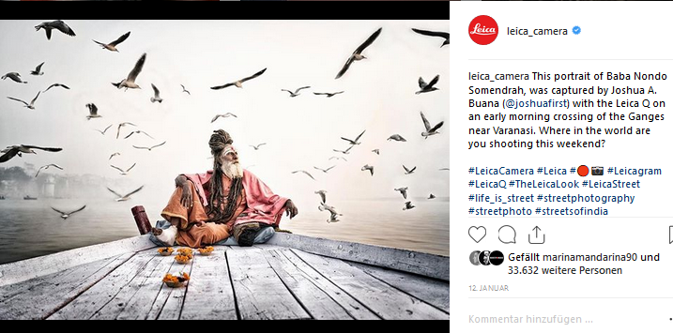
Photo Re-shares
Photo Re-shares | General Facts
Do not re-share iPhone or mobile photography or any images taken with a non-Leica product when communicating Leica relevant content. Check the Exif data of images to be sure. Exceptions can be made for images of Huawei smartphones co-engineered with Leica and Instagram Stories. Do not use unchecked stock material.
Make sure the image has maximum impact on a mobile screen. Always include a description and appropriate hashtags.
Any images with text overlays, the text should be kept minimal in the image itself and optimized for mobile (large font).
For event photos:
Include who’s in the photos in the photo description. Only share flattering images of people at events. Please consider the legal conditions for Photographs of identifiable people
in your country: http://bit.ly/2hNsF8P

Slide 32
Photo Re-shares
Photo Re-shares | Photo Credits
Always request the explicit permission from the photographer to repost their image. Ask for explicit consent to use a photographers image, specifically if the reposted image is supposed to be used within the framework of a global Leica Camera brand campaign.
Always make sure to note that the image is a repost by giving photo credit in the description. Double-check that you have the correct handle and spelling for the photographer’s name.
Don’t share images with watermarks.
How to tag the photographer:
Include the photo credits following the text copy and before the hashtags. See example. Please also make a background check of the photographer and the motive shown in the image to not share too sensitive topics or content from for example blacklisted photographers. (Blacklist s. next slide)

Slide 33
Photo Re-shares
Person | Link | Comment
Torsten Overgaard | http://www.overgaard.dk/ https://www.instagram.com/thorstenovergaard/ also admin of FB groups | proselytism for Scientology
Brigit Kripner | https://www.facebook.com/birgit.krippner | scientology/ see Overgaard
Steve Huff | https://www.facebook.com/stevehuffphoto/ https://twitter.com/stevehuffphotos | http://huffparanormal.com/about-me/ not only interested in photo. Sell "gosthunting" apps
Alessio Coghe | https://www.facebook.com/ALEXCOGHE/ https://www.facebook.com/mexicanamagazine/ | we have worked with him in the past, tried to blackmail us in order to get free products
Leicarumors | https://www.facebook.com/lrblog https://twitter.com/LeicaRumors | rumors site
La Vida Leica | http://lavidaleica.com | rumors site
Leica Craft | http://lavidaleica.com https://www.instagram.com/leicacraft/?hl=en | trademark infringement
Kamera Craft | https://www.instagram.com/kameracraft/ | division of Leica Craft
David Gensler | http://davidgensler.com/ | Creator of Leica Craft
Clive Campbell | https://www.instagram.com/fliickman/ | we have worked with him in the past, tried to blackmail us in order to get free products
Tyler Spangler | https://www.instagram.com/firsthandaccount/ | we were not able to loan him gear during the times he requested and he was disappointed and started to spam on postings
Paul Ripke | https://www.instagram.com/paulripke/ | Negative communication on his Social Media channels about the brand and also negative behavior on events
Photo Re-shares | Blacklist
Do not repost or like any Leica relevant content published on or originating from these accounts, even if other users or accounts have spread the content already!
Note: Please treat this list confidentially.
Please, check the Extranet for updates:
https://extranet.leica-camera.com/index.php/s/cX5Pcv01YR10Kfp

Slide 34
6. Asset Creation

Slide 35
Design | Colours
Colours
The pre-defined colour spectrum is representative of Leica Camera‘s brand positioning which is modern, high-quality, individual, sophisticated and timeless. Leica Camera reduces photography down to the essentials. Therefore, the colour schemes are defined as restrained and unobtrusive as well to put in focus what is most important: the photograph and its meaning.
Please remember to only use RGB. This colour mode is binding for all digital images.
Leica Camera Red
RGB 226 | 0 | 26
Leica Camera Black
RGB 0 | 0 | 0
Leica Camera Light Grey
RGB 244 | 244 | 245
Leica Camera White
RGB 255 | 255 | 255

Slide 36
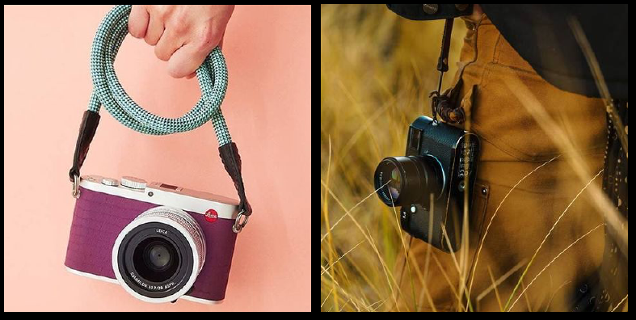
Design | Product Shots
Shooting guidelines
The positioning of the camera as part of a practical "set-up" or "gear" is important to see in the product shots and not simply a camera on a mantelpiece. Product shots with well-known photographers are also very beneficial.
It is equally important to remember the appeal of Leica's unique history and
tradition of craftsmanship. By implementing visual themes, which create a
traditional, almost vintage/analog feel, Leica can also tap into these key
concepts.
Format recommendation:
In order to get the best possible visibility within the platform, it is important
to keep a few basic points in mind:
- all posts should be in a format of 4:5, or at least 1:1
- any content that shall fit into the Instagram Story, has to be in the format of 9:16
- high-quality shots with a sharp focus on the product
- the rest of the picture should not distract from the product but support it

Slide 37
7. Videos

Slide 38
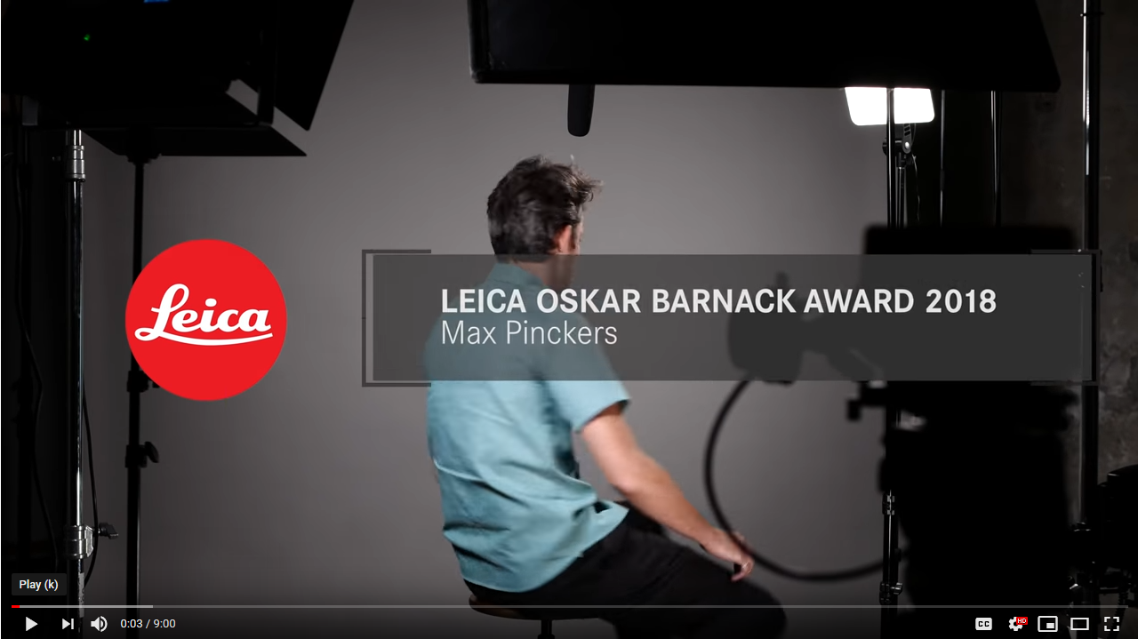
Videos on Social Media
Videos | General, Intro/Outro, Music
Please, never credit people or crew stuff in videos directly. Only use Leica and CW Sonderoptic lenses and equipment for video productions. Do not use video equipment from any other manufacturer. All releases have to be approved by Leica. Contact Christoph.Hillgaertner@leica-camera.com.
Intro/Outro:
Use the assets provided with these guidelines.
Music:
Pair video with appropriate music to match the theme, tonality, vibe, or personality of the event product. Make sure you have rights to the music.

Slide 39
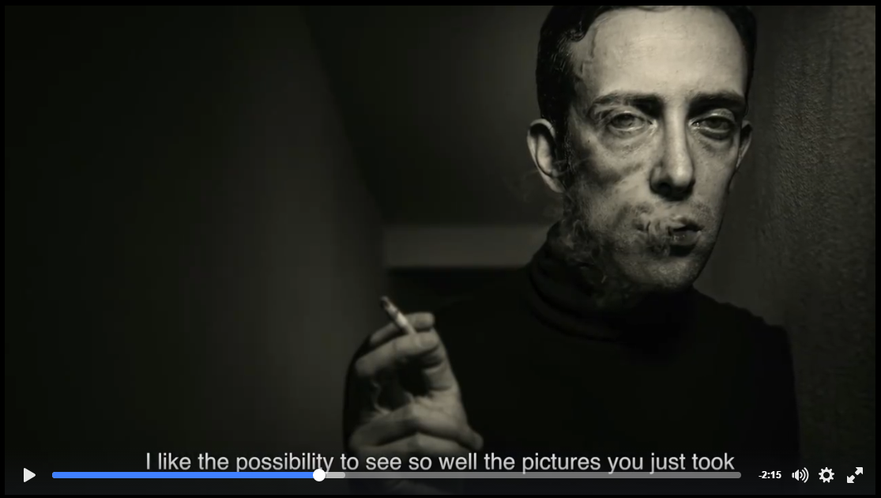
Videos on Social Media
Videos | Subtitles
All Videos/snippets that will be uploaded to Social Media directly must include subtitles in the local communication languages.
However, if a video shall be considered for publication on the Leica HQ channels, it must always include UK English subtitles.
For uploading on YouTube/Vimeo it is preferred that you upload a clean file and use the subtitling functions of the platforms, so that the viewers can optionally switch subtitles on or off.
To generate additional multi-lingual subtitles please use the Excel spreadsheet within the Toolkit ZIP file:
https://extranet.leica-camera.com/index.php/s/FdpxaBlQDn0fECj

Slide 40
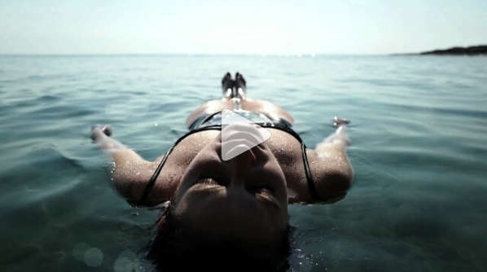
Video on Social Media
Videos | Specifications
Unless otherwise agreed, please provide following Versions of each film production:
Deliverables:
Full video FullHD MP4 – with subtitles (EN)
Full video 4K MP4 – without subtitle
Full video 4K MP4 – with subtitles
Subtitle Audio Transcript (english) with timecode (see XLS)
File attachments:
Intro / Outro Kit (PNG sequences) with black and white outro text
- 4K PNG Sequence
- Open AfterEffects Project
- Leica Fonts
Text positioning guidelines
Subtitle template XLS
Toolkit-Download:
https://extranet.leica-camera.com/index.php/s/xdBNSNt7gTfONWm

Slide 41
Video on Social Media
Videos | Length & Settings
Length & Settings: Use a social media-friendly length. Remember that most videos are watched on mobile devices, so users don’t want to watch videos that are too long. Make sure to loop all videos as looped videos receive more views.
FACEBOOK
Square video ( 1080 x 1080 px)
10- 15 s
Has to catch people’s attention within the first 3 seconds
Should be optimized for silent view.
Usage of text inserts / captions
INSTAGRAM (stories)
Vertical 9:16 ( 1080x1920 px)
Max 15 s per clip (if video is longer it has to be divided in to multiple 15s clips)
Has to catch people’s attention within the first 3 seconds
Should be optimized for silent view.
Usage of text inserts / captions
YOUTUBE
4k
Long video , no time limit,
includes Music.
Time coded script must be provided for talking heads.

Slide 42
8. Channel Dont‘s

Slide 43
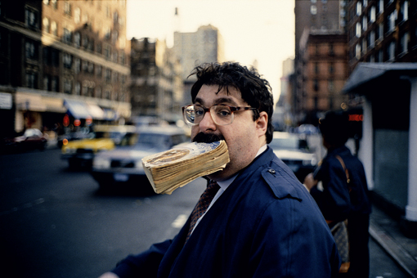
Channel Don‘ts
Channel Don‘ts
We do NOT share:
Content that violates the channel specific terms of use:
https://www.facebook.com/policies/
https://support.twitter.com/articles/18311#
https://help.instagram.com/478745558852511
https://www.linkedin.com/legal/user-agreement
https://www.youtube.com/yt/policyandsafety/communityguidelines.html
Be very careful using content depicting children or animals
We do not share mobile photography (with the exception of Huawei smartphones co-engineered with Leica, Instagram Stories) or competitor products. Images should be taken with Leica cameras and lenses.
When reposting, don’t change the original image (unless specifically arranged and agreed on by the originator).
Do not repost any content published on or originating from blacklisted accounts or without doing a background check.

Slide 44
09. Community Management

Slide 45
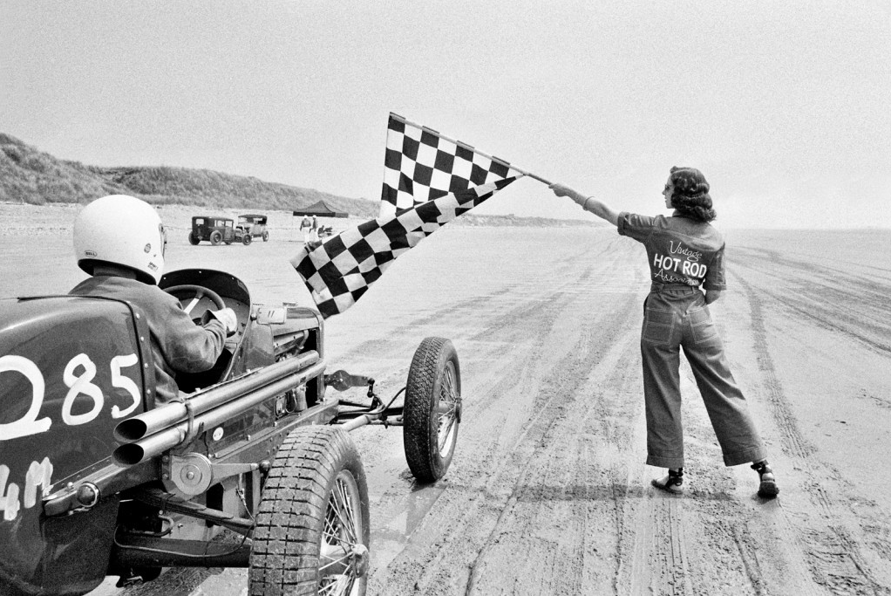
Community Management
Community Management | General
When customers reach out to you regarding Leica Camera on social media channels, please always respond and offer support.

Slide 46
Community Management
Great Customer Service
Always deliver great customer service – social media is an extension of customer service. When answering a customer service question on social media, keep a few basic principles in mind.
Respond in a timely manner (within 1-3 hours during office hours).
Respond in the spirit of genuinely wanting to help the customer to find a solution or answer.
Everything you write in emails can be copied and pasted into public blog posts!
If it’s a sensitive issue (e.g. personal information), answer via a private message and inform the user via public comment, otherwise you may answer in the comment section.
Please hide public comments containing personal user information.
If you are unsure of how to answer, do not guess, but seek help from someone who does.

Slide 47
Community Management
Community Management | Be Yourself!
All communication needs to convey authenticity and a personal touch.
Feel free to use your name in the signature of every comment and private message you send.
Example: “Marina - Leica Camera Social Media
Team”
Embrace human centric empathy and apologize when and where appropriate.

Slide 48
Community Management: Content to be deleted, hidden & blocked
Deleting
Hiding & Blocking
Warning, consult Leica
Clipping
Massive, repeated swearing, abusive language
Pornographic content
Racist, inhuman and disrespectful content
Spam & Bots
Blacklist users (depending on content)
Report „haters“ to Facebook
Commercial offers (hide the person, delete the offer & inform the person)
False statements regarding the brand
Product leaks before releases, features
Criticism & complaints with shit storm potential
Leaks (Leica Rumours)
Wrong information
Deleted messages
Very negative comments, criticism & complaints
→ Save a screenshot & include the link
Immediately
ASAP
depending on topic: immediately
ASAP, Reporting in a timely manner

Slide 49
Community Management: Process for Deleting, Hiding & Blocking
User Comment
User Comment
Commercial Offer in User Comment
If the comment contains abusive language or violates channel terms of service (e.g.
racism, violence)
If the comment contains spam, hate, profanity or commercial offers
If the comment contains a commercial offer (e.g. offers by other brands, links to Ebay auctions, etc.)
Delete the comment and block the user right away. Report them to respective Social Media Network, clip comments.
Hide the comment and send user a warning via Direct Message.
Hide the comment and send user a warning via Direct Message.
If the user comments more than three times in this way
Block the user & report them to respective Social Media Network, clip comments

Slide 50
Community Management | Leica Partners Behaviour
Leica Partners Behaviour | Forums & Communities
While all Leica Camera partners are welcome to participate in Social Media, we expect everyone who participates in online commentary to understand and to follow these simple but important guidelines. These rules might sound strict and contain a bit of legal-sounding jargon but please keep in mind that our overall goal is simple: to participate online in a respectful, relevant way that protects our reputation and of course follows the letter and spirit of the law.
1.
2.
3.
Be transparent and state that you cooperate with Leica Camera.
Your honesty will be noted in the Social Media environment. If you are writing about Leica Camera, use your real name, identify that you work with Leica Camera, and be clear about your role.
If you have a vested interest in what you are discussing, be the first to say so.
Never represent yourself or Leica Camera in a false or misleading way.
All statements must be true and not misleading; all claims must be substantiated.
Post meaningful, respectful comments — in other words, please, no spam and no remarks that are off-topic or offensive.

Slide 51
Community Management | Leica Partners Behaviour
Leica Partners Behaviour | Forums & Communities
4.
5.
6.
Use common sense and common courtesy: For example, it’s best to ask permission to publish or report on conversations that are meant to be private or internal to Leica Camera.
Do not post any information about products before the embargo date. Never communicate insights on product development.
Make sure your efforts to be transparent don't violate confidentiality, and legal guidelines for external commercial speech.
Stick to your area of expertise and do feel free to provide unique, individual perspectives on non-confidential activities at Leica Camera.
When disagreeing with others' opinions, keep it appropriate and polite.
If you find yourself in a situation online that looks as if it’s becoming antagonistic, do not get overly defensive and do not disengage from the conversation abruptly: Feel free to ask the Corporate Communications Team and/or to disengage from the dialogue in a polite manner that reflects well on Leica Camera.

Slide 52
Community Management | Leica Partners Behaviour
Leica Partners Behaviour | Forums & Communities
7.
8.
9.
Do not write anything about competitors. Do not compare products or gloat over quality issues and/or company results.
Please never comment on anything related to legal matters, litigation, or any parties Leica Camera may be in litigation with.
Never participate in social media when the topic being discussed may be considered a crisis situation.
Please always identify yourself clearly. Even anonymous comments may be traced back to your or Leica Camera’s IP address.
Refer all Social Media activity around crisis topics to your local PR team and/or HQ Corporate Communications.

Slide 53
Community Management | Leica Partners Behaviour
Leica Partners Behaviour | Forums & Communities
10.
11.
12.
Be smart about protecting yourself, your privacy, and Leica Camera’s confidential information.
What you publish is widely accessible and will be around for a long time, so consider the content carefully. Google has a long memory.
Please never “like” or interact with blacklisted channels or channels and content referring to rumors about Leica Camera, its products and/or Leica Camera’s management.
Mainstream media inquiries must de referred to your local PR team or to the HQ Corporate Communications team if the question is related to an HQ topic (results, strategy, top management, shareholders).

Slide 54
Appendix
1.
2.
3.
4.
Content Communication Process
Image Guidelines
FAQs
Responsibility

Slide 55
1. Content Communication Process

Slide 56
Content Communication Process | Content Selection
Likelihood of Social Media placement across global channels
High Priority
Medium Priority
Low Priority
Big local events that receive global recognition (e.g. Paris Photo)
Leica Store openings
A- list celebrity endorsement
Content that has already generated extremely high reach/engagement
Influencer and VIP tie-ins, like page takeovers or cross-promotions
Product-related tie-ins with influencers
Exhibition openings
Local campaigns
Product-related content and reviews
Local product Special Editions
Spontaneous influencer event (store visits etc.)
Local product-related photographer content
Small local events
Local holiday actions (Chinese New Year, Thanksgiving, etc.)

Slide 57
2. Image Guidelines

Slide 58
Image Guidelines | Social Media | Facebook
For the latest recommended image sizes on various social channels please check this:
https://makeawebsitehub.com/social-media-image-sizes-cheat-sheet/

Slide 59
3. FAQs

Slide 60
Appendix | FAQs
IN GENERAL:
If you are not certain about particular questions or requested information, please don’t hesitate to contact ansgar.wehnge@leica-camera.com
The four-eye-principle for any outbound communication is recommended for sensitive topics.

Slide 61
Vielen Dank für Ihre Aufmerksamkeit!
Leica Camera AG / Am Leitz-Park 5 / D-35578 Wetzlar
Name Ansprechpartner / Position / Telefon +49(0)6442-208-xyz / vorname.name@leica-camera.com

